Slide 1
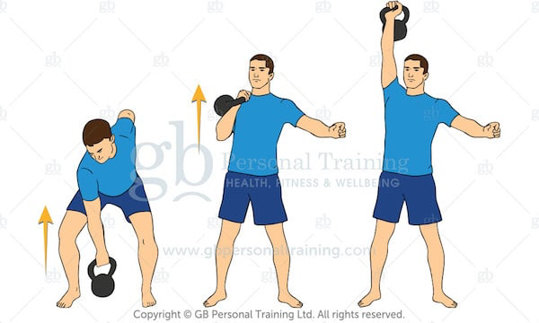
Kirsty’s Kettlebell Technique Tips The clean and press
Step by step:
The clean and press is a combination of two moves, the kettlebell clean and the shoulder press.
The clean: Keep the kettlebell close to the body
Over hand grip, bend at the hip.
Extend at the hip to lift the kettlebell.
Rotate the hand out so the kettlebell travels around the outside of the hand not over the hand.
Bring the kettlebell into the Racked position at the top, elbow against your ribs, kettlebell resting on your forearm.
The press:
The kettlebell should now be in the racked position (elbow against ribs, kettlebell on the outside of the forearm, palm facing in).
From this racked position you press the kettlebell up, extending at the elbow, keeping the kettlebell in line with the shoulder. Engage your core in this overhead position. Repeat.

